Slide 1
PAH159 - Polestar PDP Add to Bag Module - Mobile
Test Plan

Slide 2
Overview
1
Rationale & Hypothesis

Slide 3
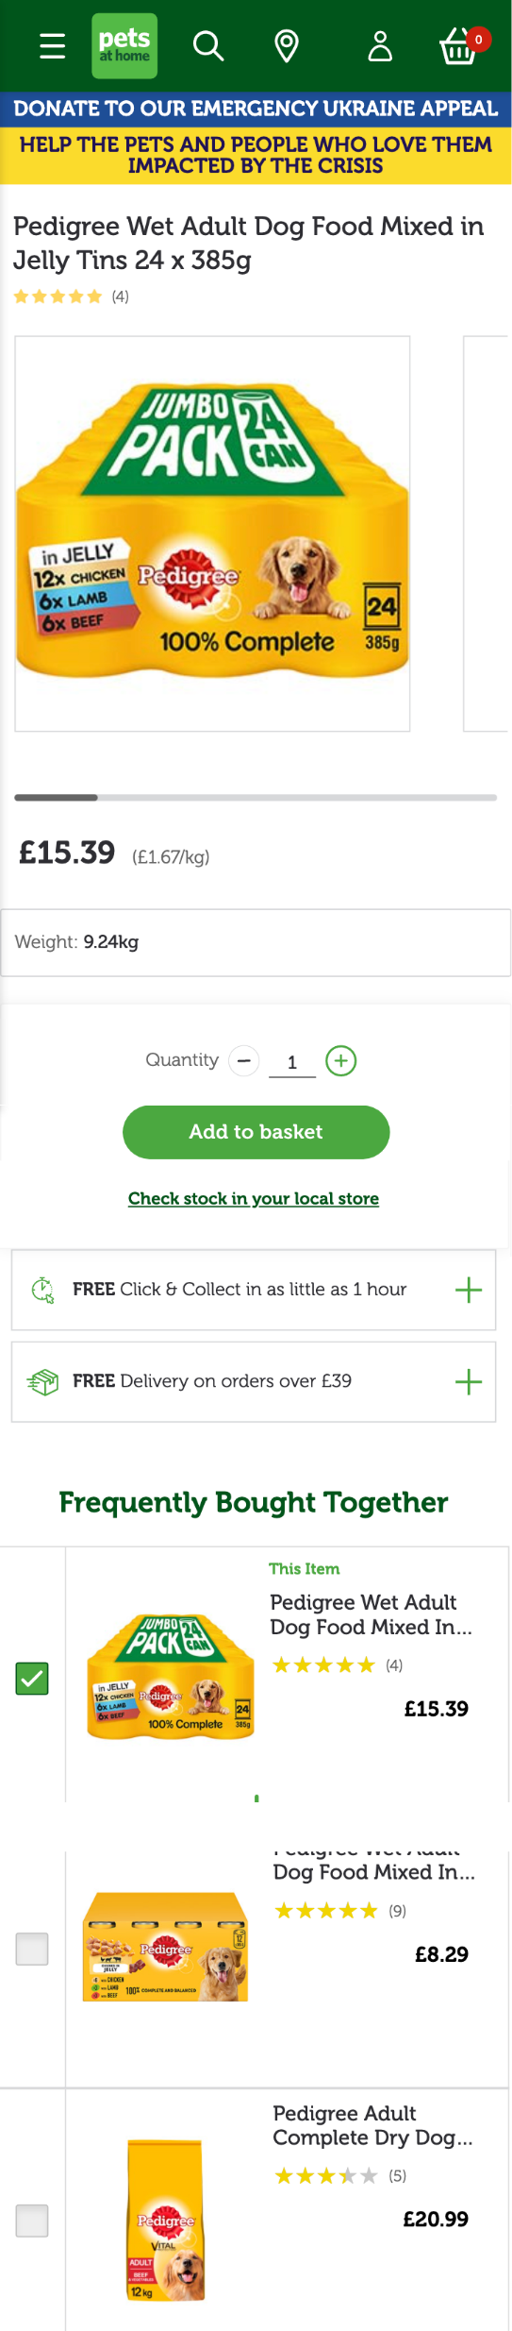
Rationale
Why are we running this test?
Through conducting user research, additional research from external partners, and internal discussions, we’ve found the dual CTA design of the PDP to be divisive.
We believe that the inclusion of an additional CTA is a distraction as it places additional cognitive load upon the user by asking them to decide their fulfilment method at the same stage as they are deciding if they wish to purchase a product.
This theory is supported in research conducted by Baymard who observed that “as more is packed into the “Buy” section, subjects were less able to focus on adding a product to their cart and became more focused on the other information and options available to them. In effect, cluttered “Buy” sections distract users from the primary task of adding the product to their cart, which can delay or even deter users from completing it.”*
Previous testing around this area has shown that reducing the dual CTAs to a single, unified CTA can result in reasonably large statistically significant improvements to Add to Basket Rate.
Additionally, we currently default to Click and Collect at the delivery selection stage of the checkout unless the user has otherwise chosen Delivery on the PDP. Users would not be able to make this decision on the PDP with a single CTA though. As Click and Collect transactions account for the minority of our transactions, we
This test aims to build on the results of the previous test (PAH131) and further inform the Polestar PDP designs, that currently feature a single CTA.

Slide 4
Variations
2
Designs & Summary of Changes

Slide 5
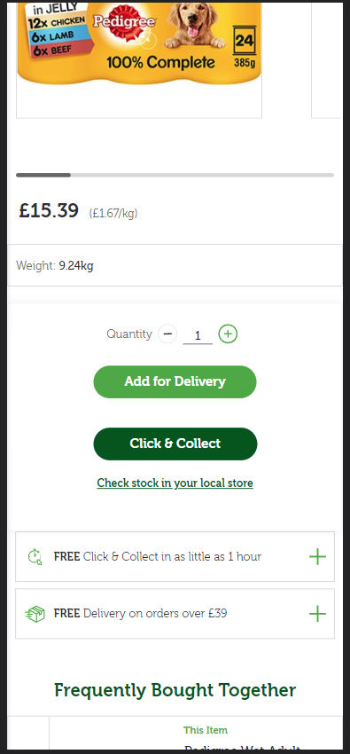
Control - PDP
What is the current PDP experience?
The control version of the PDP features both fulfilment methods as individual CTAs, vertically stacked below the price information.
When the user clicks “Add for Delivery” the product is added to their basket and they are presented with a confirmation message.
When the user clicks “Click & Collect”:
If the user is logged in or they’ve previously selected a store, and the product is available, the product is added to their basket and they are presented with a confirmation message.
If the user isn’t logged in or hasn’t selected a store, they are prompted to search for and select a store, at which point the product is added to their basket and they are presented with a confirmation message.

Slide 6
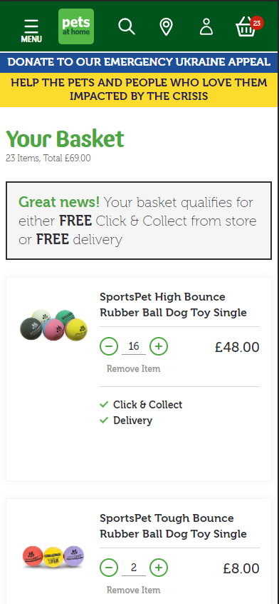
Control - Basket
What is the current Basket experience?
Depending on how a user has added items to their basket, they will be greeted with different versions of the delivery messaging.
If a user has added a product to the basket from the PLP, they will see a message advertising both Click and Collect, and Delivery.
If they add a product to the basket from the PDP via the “Add for Delivery” CTA, they will see a message advertising the Free Delivery threshold.
Alternatively, if a user selected Click and Collect on the PDP, they will see a message advertising Click and Collect.

Slide 7
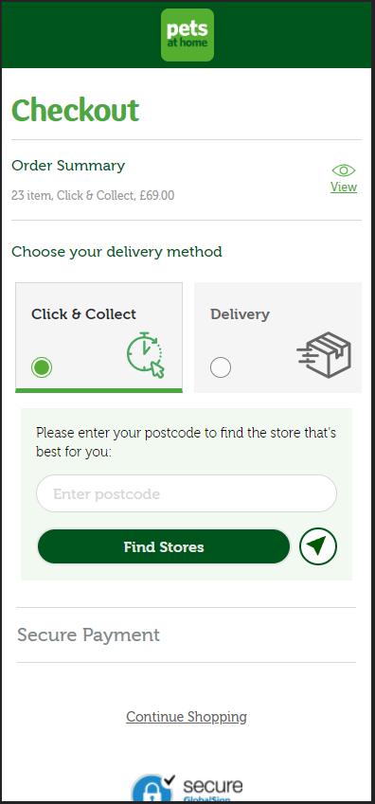
Control – Checkout Delivery Selection
What is the current Checkout Delivery Selection experience?
By default, Click and Collect is pre-selected when a user reaches the delivery selection step of the funnel.
However, if a user has selected Delivery at an earlier point in the user journey then Delivery will be pre-selected.
If one of these options is unavailable for any reason, we will pre-select the available one.

Slide 8
Variation 1
What are we changing?
PDP
Single Add to basket CTA
Basket
Add additional messaging below “Delivery options can be selected at checkout.”
Checkout
Deselects delivery method if delivery and C&C available.
Reverts to default, control, experience if one of the delivery methods isn’t available

Slide 9
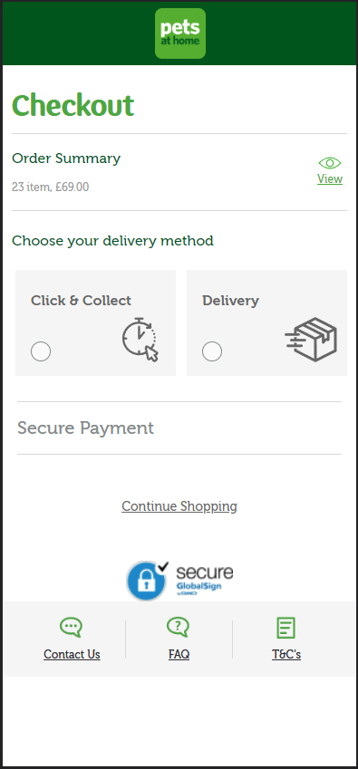
Variation 1
PDP
Basket
Checkout Delivery Selection

Slide 10
Variation 2
What are we changing?
PDP
Single Add to basket CTA
Basket
Add additional messaging below “Delivery options can be selected at checkout.”
Checkout
Preselects C&C method if delivery and C&C available.
Reverts to default, control, experience if one of the delivery methods isn’t available

Slide 11
Variation 2
PDP
Basket
Checkout Delivery Selection

Slide 12
Variation 3
What are we changing?
PDP
Single Add to basket CTA
Basket
Add additional messaging below “Delivery options can be selected at checkout.”
Checkout
Preselects delivery method if delivery and C&C available.
Reverts to default, control, experience if one of the delivery methods isn’t available

Slide 13
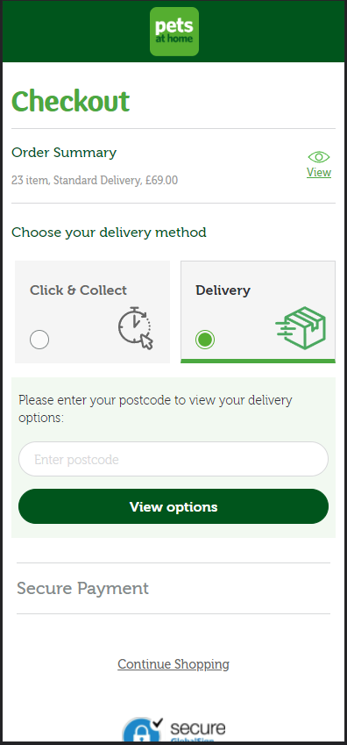
Variation 3
PDP
Basket
Checkout Delivery Selection

Slide 14
Test Configuration
3
Targeting, Timeline, & Tracking

Slide 15
Configuration
Key Metrics & Segments
Where will the test run?
The test will run across all mobile product pages.
Excluding Flea product pages to prevent experiences clashing
Excluding Easy Repeat product pages to simplify the test
What browsers/devices will the test run on?
The test will run on all mobile browsers/devices.
How long will the test be live?
We estimate this test will be live for 1 to 3 weeks based on recent product page testing.
Key Metrics
The primary KPI that we will base the test’s success on is Add to Basket Rate.
For our secondary KPIs, we will measure the subsequent progression through the funnel to support our analysis of each variation.
We will also place increased importance on this tests impact on Click & Collect transactions.
Key Segments
New & Returning Users
Paid Traffic Users (Google Shopping, Paid Social, & PPC Traffic)
Users that land on a PDP (the first page visited)

Slide 16
Tracking
4
Segment, Dimension, & Metric Definitions

Slide 17
E-commerce Segment-Based Metrics
E-commerce Built-in Metrics
Add to Basket
Dimension: Shopping Stage
Value equals: ADD_TO_CART
Basket Progression
Dimension: Shopping Stage
Value equals: CHECKOUT_1
Checkout Step 2 Progression
Event Category = Ecommerce
Event Action = Checkout Step
Event Label = 2
Checkout Step 3 Progression
Event Category = Ecommerce
Event Action = Checkout Step
Event Label = 3
Variant Impression
Custom Dimension: 22 (Optimisation Slot #1)
Value is one of the following:
pah159: Control
pah159: Variation 1
pah159: Variation 2
Transactions
E-commerce Conversion Rate
Revenue
Avg. Order Value
Order Delivery Type
Order Type

Slide 18
Conclusion
5
Please direct any questions to the Pets at Home Optimisation team.

